Slide 1
Laptop Dataset Analysis
A look at what the dataset presents to us about the laptop market.
By Deividas Petreikis

Slide 2
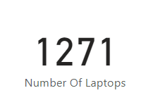
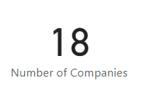
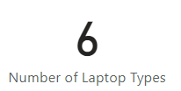
Genral Look At The Stats
After Cleaning the dataset I was able to visualise the information in Power BI.
Due to the dataset being small we can view the and group the laptops in order to see what the best laptop is for its price.
When looking at the dataset I was able to gather that there are 1271 laptops that were taken into account, with there being 6 distinct laptop types categorising them. From which 18 companies were the manufacturers of the laptops.

Slide 3
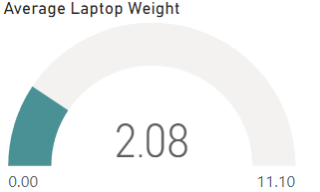
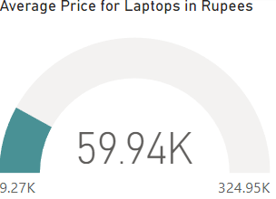
Viewing the Average Values
Looking at the table I was able to visualise the average values of laptop weight and the price of the laptops.
For the weight the average was 2.08 Kg due to companies trying to make their laptops light as possible as seen by the minimum being 0.00.
With the dataset being in Ruppe's, the price is price is seen as quite high. However converting this price to GBP the average is £582.42. Making the average price not as expensive as initial thought.

Slide 4
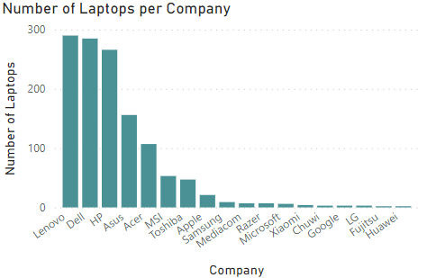
Number Of Laptops
While traversing through the dataset I wanted to know the company that had the most laptops within the dataset. I created a visualisation of this, which showed Lenovo as having the most laptops in the dataset with Huawei having the least.
With this I can see that the company with the most variety for laptops is Lenovo.

Slide 5
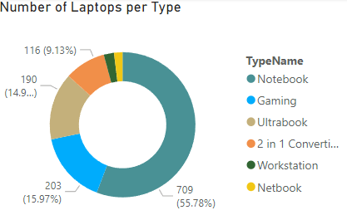
Types Of Laptops
After finding out the highest producing companies, I wanted to look into the percent of laptops made by type.
From the donut graph I can see that the Notebook is the highest percent of laptops present in the dataset at 55.78%, with the second type being gaming at 15.97%.
In order to get a laptop for work I believe that the Notebook is the best choice as it is the highest produce meaning there is more variety in what I can choose.

Slide 6
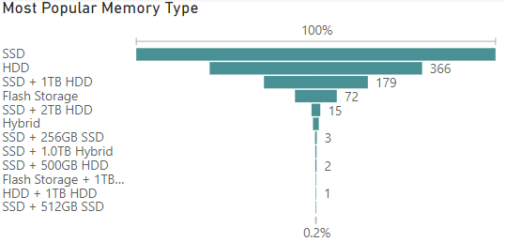
Popular Storage Type
Looking at the storage type it gives me a better understanding on the hardware of the laptops and the most popular type means that repairs would be easier as they would be in stock.
With this in mind, I believe that a laptop with SSD would be the best choice as it has the highest amount of laptops that are present with this storage type.

Slide 7
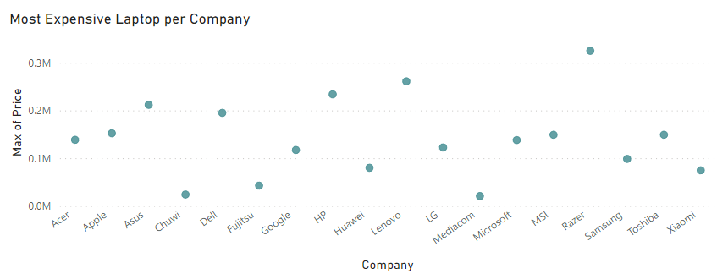
Most Expensive Laptops
To get an overall understanding of the laptop market I wanted to view the prices of laptop per company, especially that of which is the most expensive per company.
From the scatter graph we can see that Razer has the most expensive laptops on the market while Mediacom and Chuwi have the most cheapest laptops on the market.
Overall, I believe that I would go for a laptop that is based in the middle as that would have the market average price and a more well know company name.

Slide 8
Conclusion
When looking through this data and visualisations I was able to come to the conclusion that the best laptop would that of Lenovo or Dell which is a notebook with a SSD storage type.
This gives me a good basis of what I should be looking for when I decide to go and purchase a laptop for myself. This could also be used by other people who wish to do the same as they can view the data and visualisations and come to their own conclusions on what they wish to purchase.

